Slide 1
Shopping App Web API
Julian Metzger

Slide 2
Web API Objective
Allow the client to manage their customers, customer orders, and the items that compose those orders.

Slide 3
Technology
.NET Framework
ADO.NET
Microsoft Visual Studio
Microsoft SQL Server Management Studio
Model Controller Design Pattern
Serilog Diagnostics Log

Slide 4

Model Controller
MC
Stock Details
Customer Details
Order Details
Order Info
Ordered Items
Diagnostics Log
Current
New

Slide 5
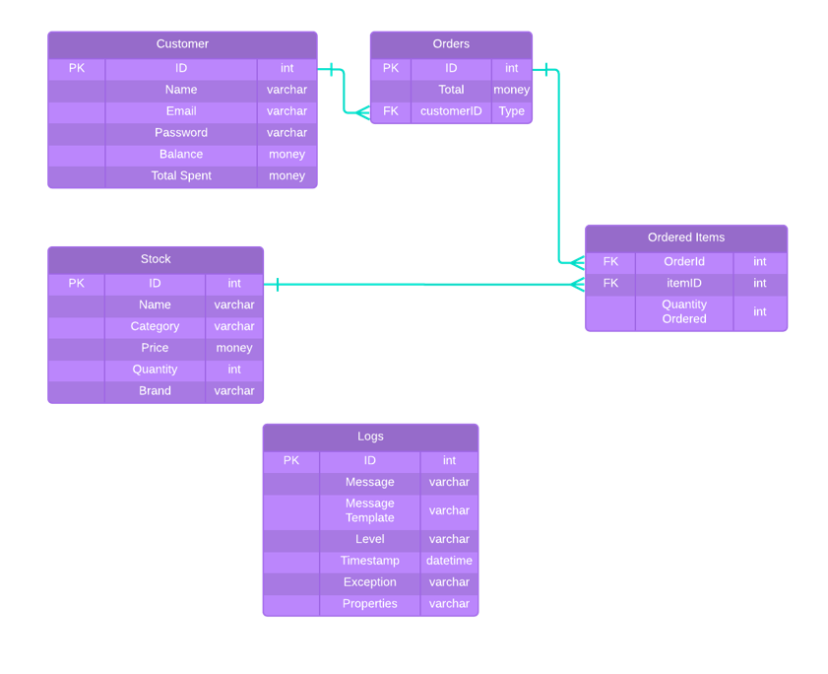
ER Diagram

Slide 6
Stock
Database table and Web API Model.
ID | Name | Category | Price | Quantity | Brand
1 | Burger | Fast Food | 2.50 | 74 | Carls Jr.
Contains vital information about stocked items for management and transactions.
ID: Primary key for the item. Auto-generated.
Name: Given by the client.
Category: Given by client.
Price: USD.
Quantity:
Brand:

Slide 7
Stock Functions
Search Stock: Search for stocked item by ID.
List Stock: Lists all stocked items currently in the database.
Restock Item: Updates stock quantity given a restock amount.
Update Price: Changes the price of an item.
Delete Item: Delete an item from the database.
Add Item: Add a stock item to the database.

Slide 8
Customers
Database Table
ID | Name | Email | Password | Address | Balance | Invoice Total
1 | Julian Metzger | Julian@gmail.com | Password | 123 Memory Lane | 42.00 | 164.00
Customer API Model: Contains vital information for the customer without exposing their password.
ID: Customer ID. Auto-generated. Primary key for customer’s present and past orders.
Name: Customer’s name for shipping purposes.
Email: Email associated with account.
Address: Needed for delivery and confirming shipping address.
Balance: Customer’s current balance. Cannot be negative!
Invoice Total: Total amount the customer has spent through this API.
New Customer Model: Contains only the necessary information to create a new account.
Name
Email
Address
Initial Balance
Password

Slide 9
Customer Functions
Add Customer: Adds a customer to the database.
List Customers: Lists all customers currently in the database.
Search Customer: Search for a customer based on ID.
Customer Invoice: Lists Customer’s orders, items associated with those orders, and the total amount spent by the customer per order and overall.
Deposit Funds: Deposits funds into Customer’s balance.
Delete: Removes the customer from the database.

Slide 10
Orders
Database Table
orderID | customerID | orderTotal
1 | 2 | 52.00
Contains vital information pertaining to the order:
orderID: Primary key referenced by Ordered Items to be associated with a single order or “cart.”
customerID: Foreign key that references the customer for transaction and shipping.
orderTotal: Order total before tax is applied.

Slide 11
Ordered Items
Database Table
orderID | itemID | Amount
15 | 2 | 21
Contains vital information pertaining to the ordered item:
orderID: Foreign key references the Order the item is associated with.
itemID: Foreign key that references the stocked item ordered.
Amount: Amount of a stocked item that is ordered.

Slide 12
Order Functions
Search Order: Search for an order by ID.
Search Order (verbose): List an order and its associated items.
Place Order: Places an order for a customer given they have sufficient funds.
List Orders: Lists all orders currently in the database.

Slide 13
Log
Database Table
Diagnostic information concerning HTTP requests, controller routing, and exceptions.
ID: Primary key for a logged event.
Message: Specific message describing the event.
Message Template: Template that receives specifics to describe the event.
Level: Minimum level of the event. Defaults to information (almost everything).
Timestamp: Describes exactly when the event occurred.
Exception: If an unhandled exception has occurred, the log is given the exception message in full.
Properties: Metadata pertaining to HTTP calls and variables applied to the message template.

Slide 14




On to the ApI!

